Slide 1
Features Implemented
Data Manipulation
Data Augmentation
Histogram Equalization on all training + test data
Histogram Equalization on final detector image
Feature Descriptor
Full Image (Raw pixels)
  PCA
HOG
Gabor
Classifier
K-NN (including 1-NN)
SVM
Standalone Decision tree
Random Forest
AdaBoost
MLP
Detector
NMS
Multi-scale sliding window

Slide 2
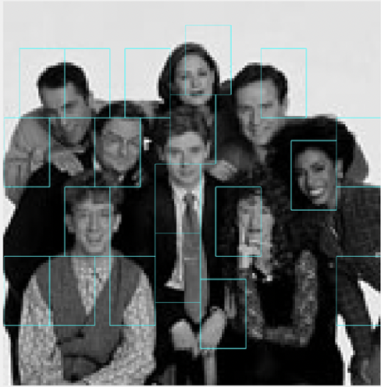
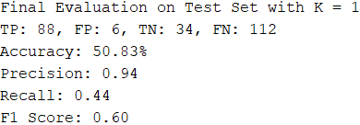
Full Image → KNN version 1/3
Our first pipeline began with using the Full Image as the feature descriptor and using KNN to classify them.
Features already included by this stage includes:
NMS (Non-Maxima Suppression)
Histogram Equalization optionality on training/test data, AND SEPARATELY, detector image.
The KNN algorithm we implemented finds the best K with highest accuracy during cross validation, when given a range of K.
We used a range from 1 to 90, as we noticed accuracy would start to drop after around K = 60.
Naturally, this means 1-NN is included in the model.
If K = 1 (i.e. 1-NN)

Slide 3
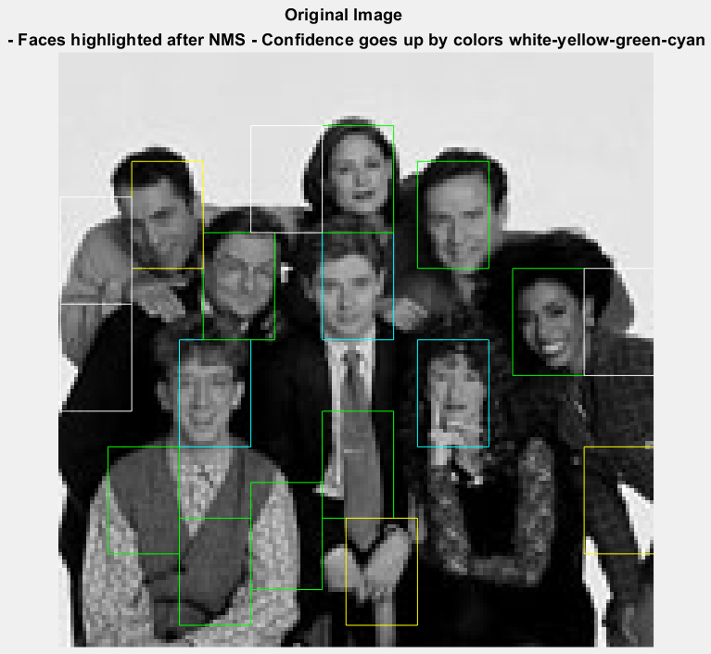
Full Image → KNN version 2/3
The major improvement in this version was adding confidence level to the algorithm, so we can see how certain the program is about detecting a face or not.
Each colour represents certain confidence threshold:
Cyan – >90%
Green – >70%
Yellow – >50%
White - <50%
*Following NN/KNN models all have this confidence score feature implemented

Slide 4
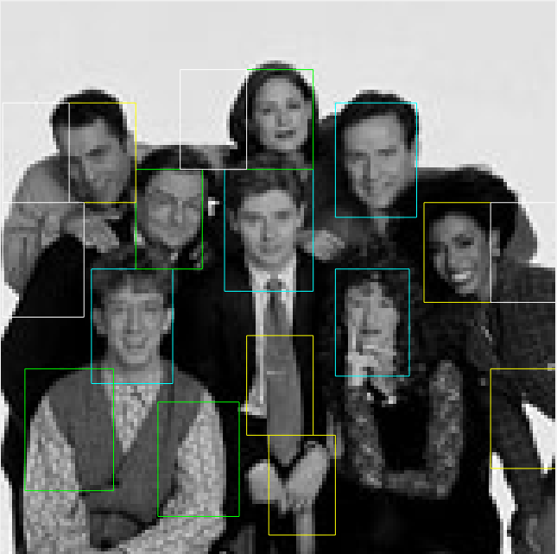
Full Image → KNN version 3/3
The last version of Full Image → KNN implements multiscale sliding window detector.
The faces are better captured due to the different face size and overall image size.
*Following models all have this multiscale sliding window detector feature implemented

Slide 5
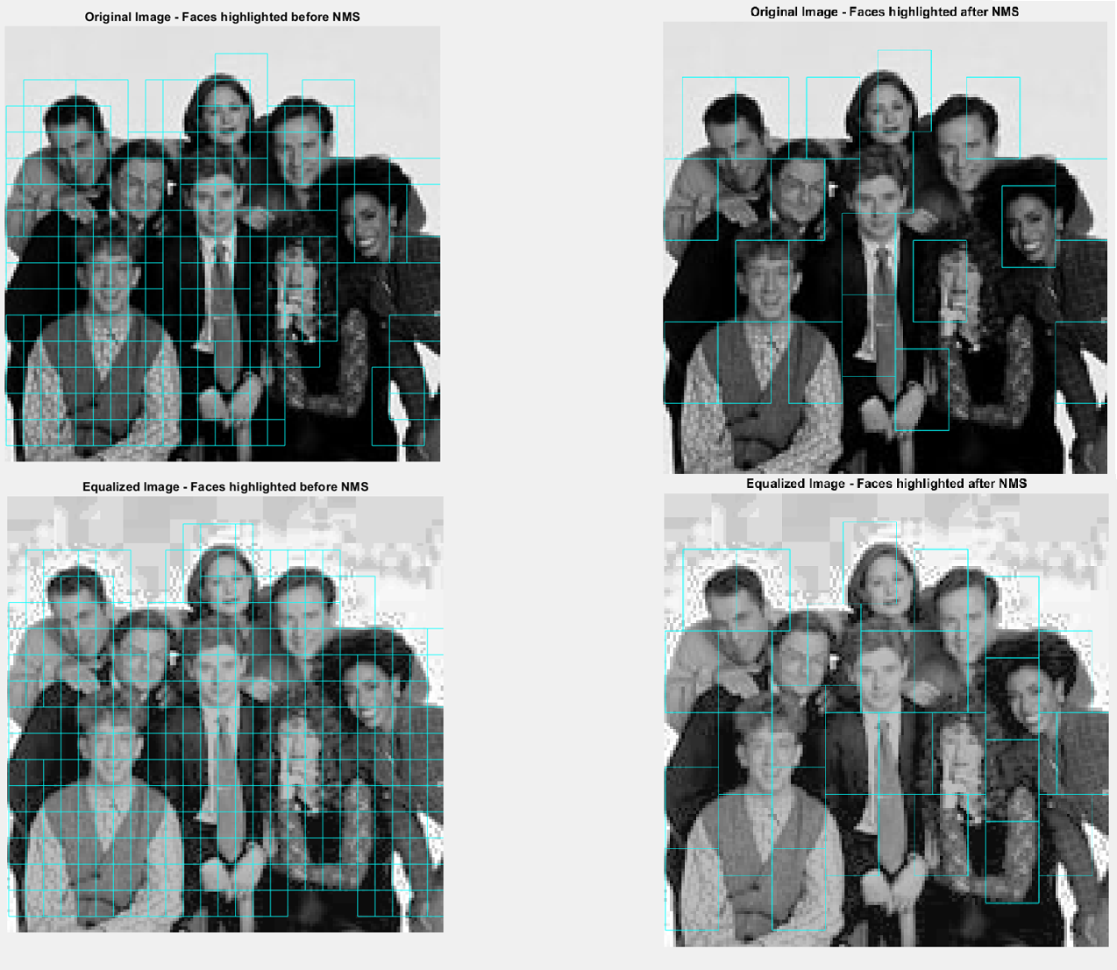
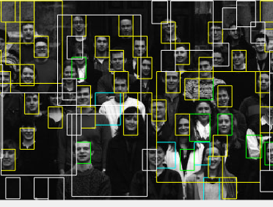
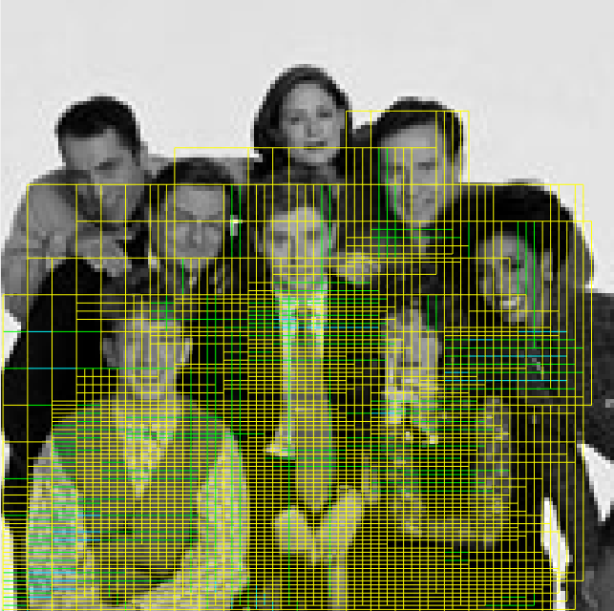
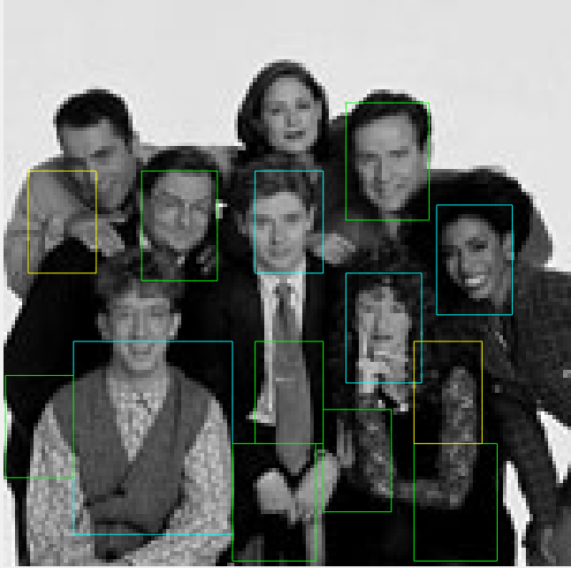
NMS (Non-Maxima Suppression)
Threshold is important.
In general, value should be as low as possible. It was noted that in some cases, even say 0.05 was not enough. Below is an example:

Slide 6
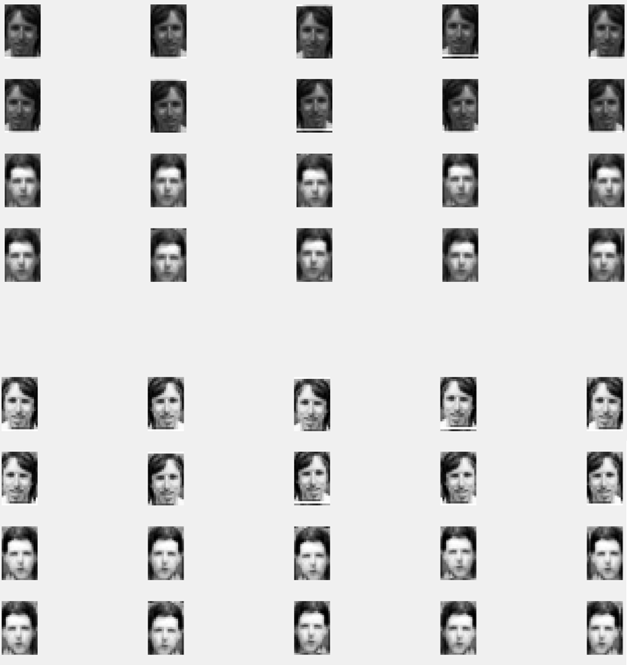
Histogram Equalization (on training+test data)
For histogram equalization, we tried to apply it to the training data and test data , as well as the final detector image, to see how the performance varies.
In general, from testing during cross validation, performing histogram equalization on the training+test images tended to lower the accuracy of the models. So henceforth, all the model training/testing were performed with the histogram equalization option turned off.
  However, it is noticed that the accuracy from cross validation does not necessarily correlate closely to success in the detector phase. (We’ll see this later)

Slide 7

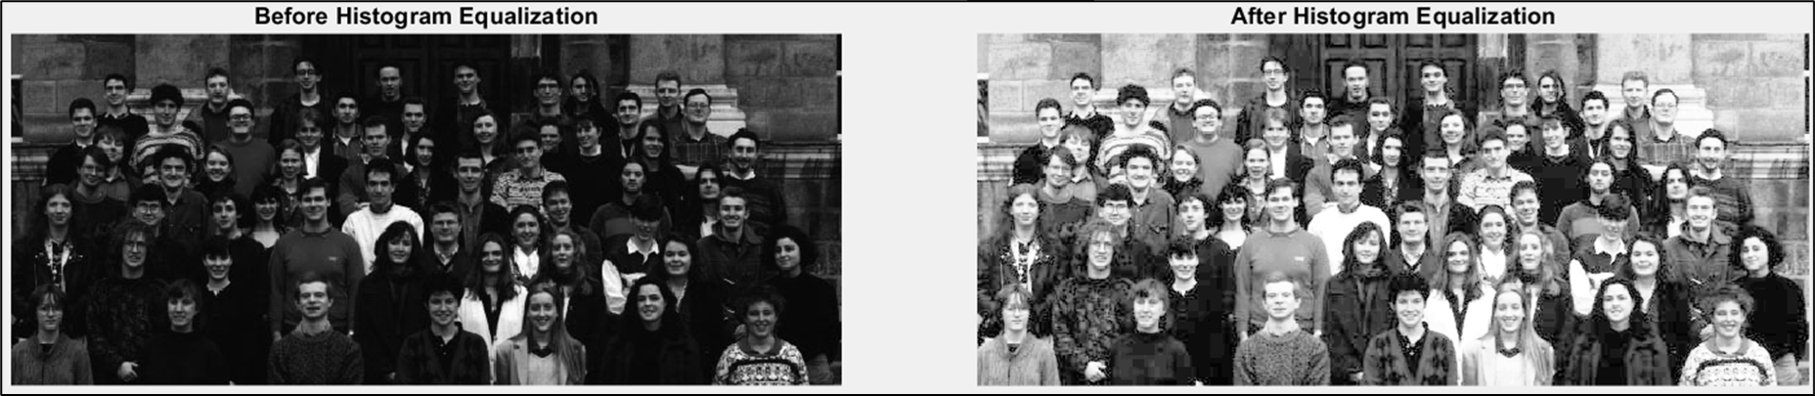
Histogram Equalization (on detector image)
We tried histogram equalisation as the pre-processing method because it automatically finds the most details in an image.
It was off+on’d to all detector images, to see how the models would do on them. In general again the faces were not detected necessarily better.
Seen below, as a good example, it reveals the crowd a lot better.
  … but in our testing, models did not fare better with it on too. (May be because Full Image descriptor was the only descriptor that worked well in general for us, and it doesn’t work well with histogram equalisation as compared to Haar, for example.)

Slide 8
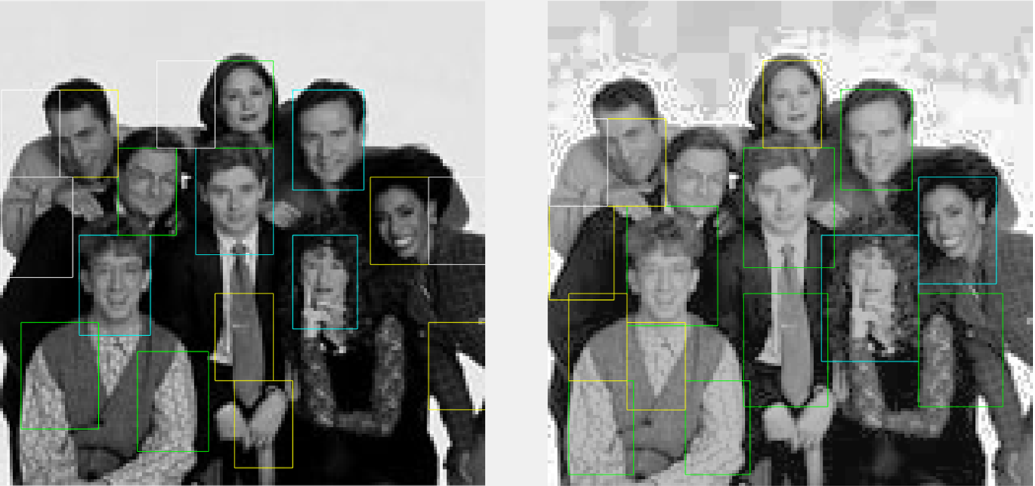
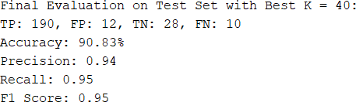
Full Image → KNN – Notable evaluation
Histogram Equalization OFF on training + test data
Note how the woman with darker skin tone was noted more confidently after histogram evaluation. This is probably due to how the model learned off of white faces, and full image as a feature descriptor does exactly that, as compared to Haar features for example, which perform calculations relative within a face.

Slide 9
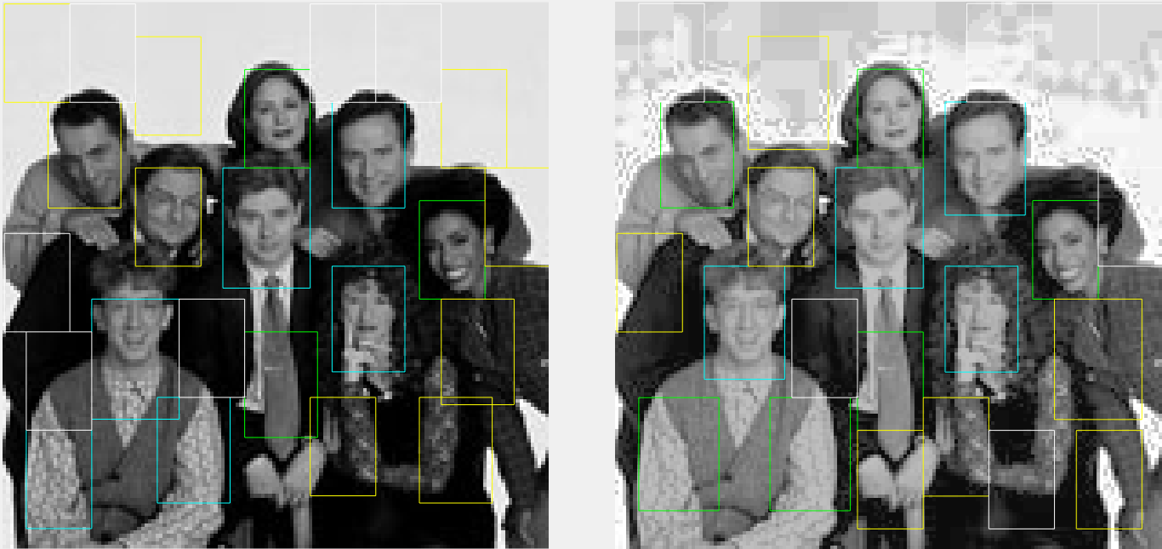
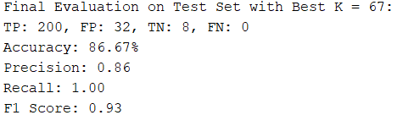
Full Image → KNN – Notable evaluation
Histogram Equalization ON on training + test data
Despite the accuracy going down when histogram equalization is turned on for training+testing, the detector seems to have slightly better success.

Slide 10
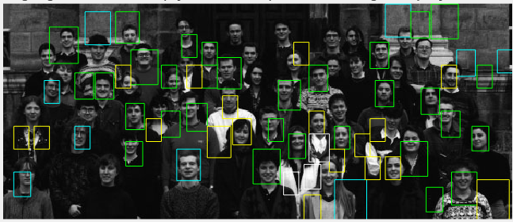
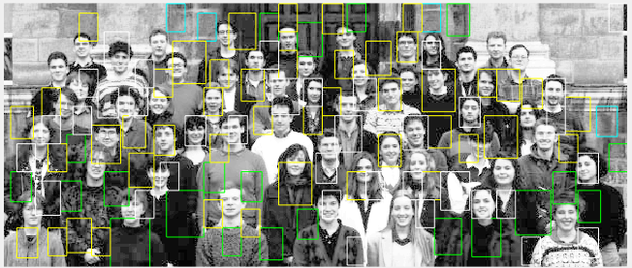
Histogram
Equalization
OFF:
Histogram
Equalization
on training data OFF…
On detector image…
Histogram
Equalization
ON:

Slide 11
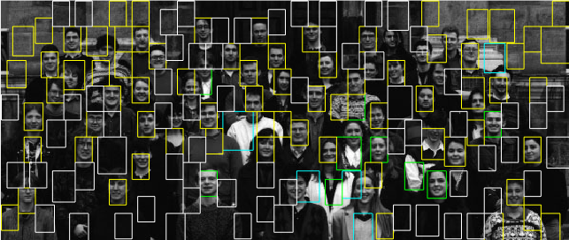
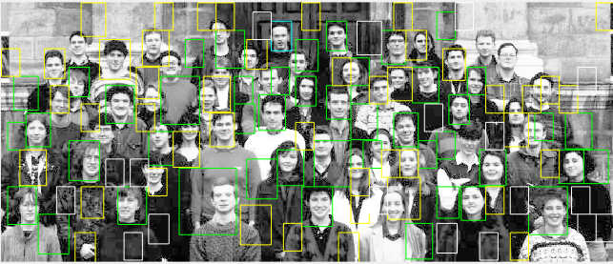
Histogram
Equalization
OFF:
Histogram
Equalization
on training data ON…
On detector image…
Histogram
Equalization
ON:

Slide 12
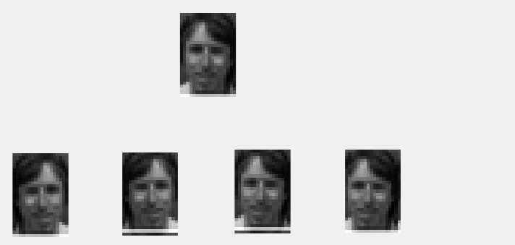
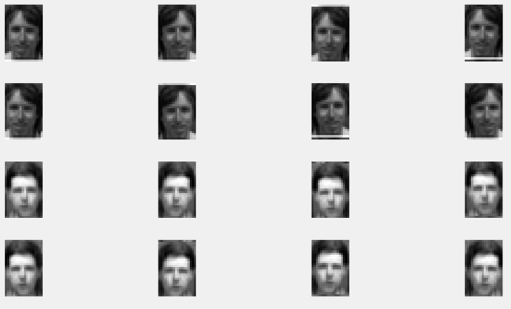
Data Augmentation
Data Augmentation was also added to the first version and every later ones to give more training data for the model to boost accuracy. The data set increased from 124 images to 910.

Slide 13
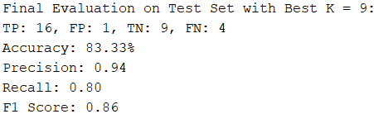
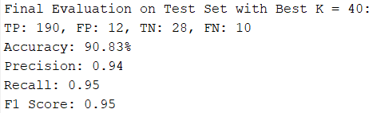
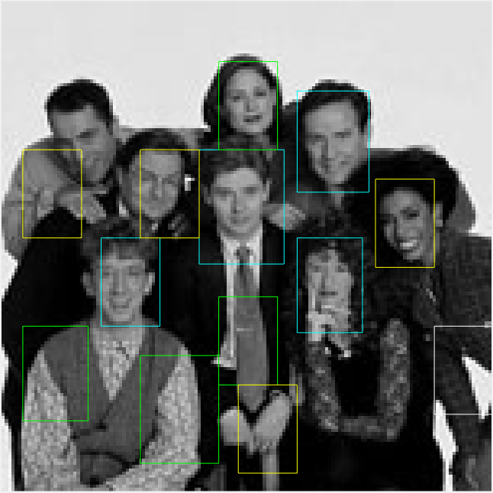
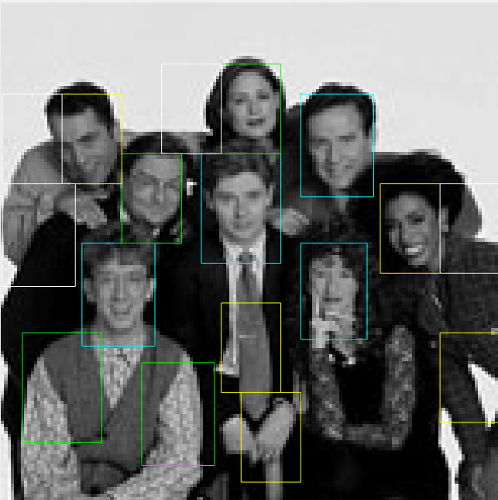
Full Image → KNN without/with data Augmentation
Without (Note the test dataset size of 30)
With (Note the test dataset size of 240)

Slide 14
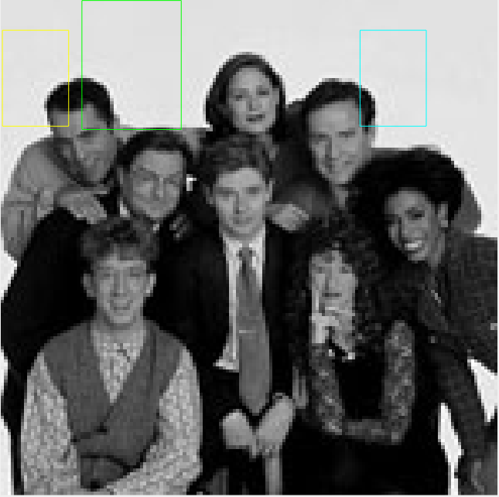
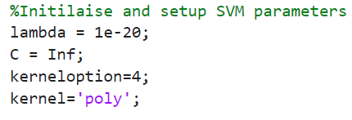
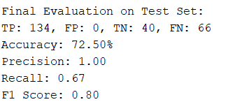
Full Image → SVM – Default Parameters

Slide 15
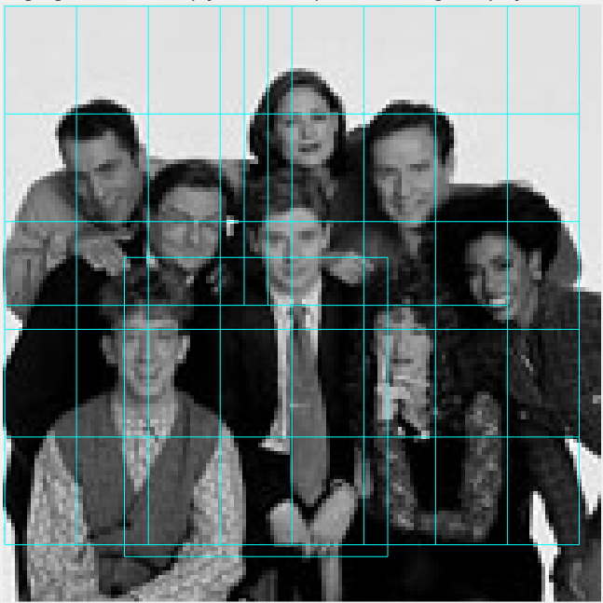
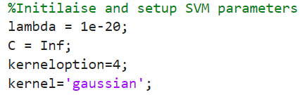
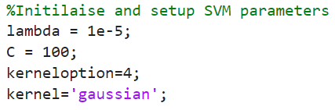
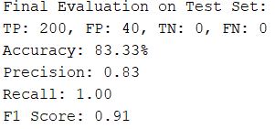
Full Image → SVM – Parameter Tuning
We attempted some parameter tuning, but the model's results remained inaccurate. From the result window, we can see that it classified every single image from the test dataset as a face.

Slide 16
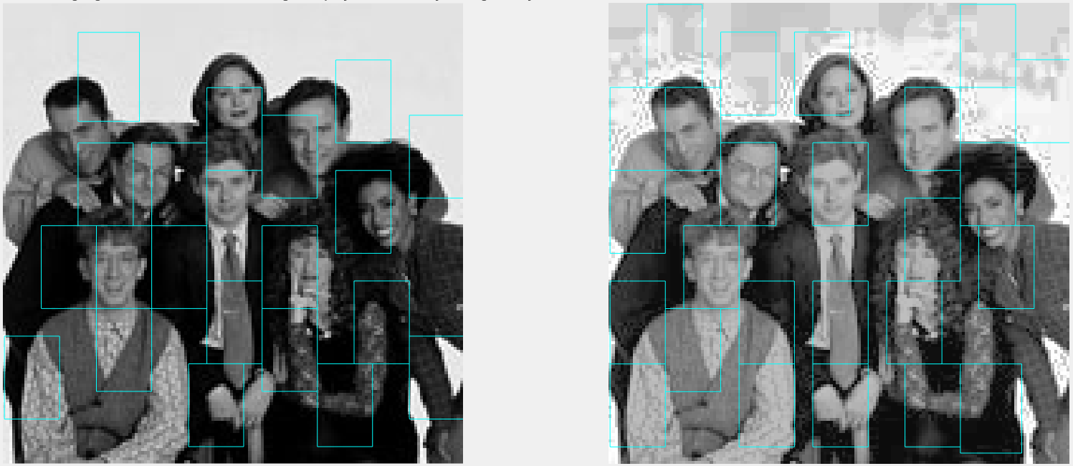
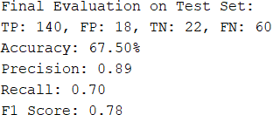
Full Image → Standalone Decision Tree
Whilst it had reasonable accuracy on the test dataset. In practice during the detector, it did not capture faces very well.
Notable: hist eq’d image seemed to do a bit better

Slide 17
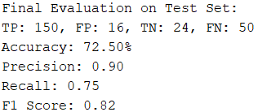
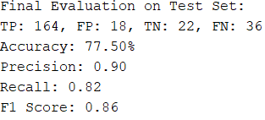
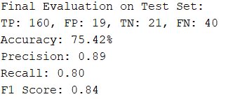
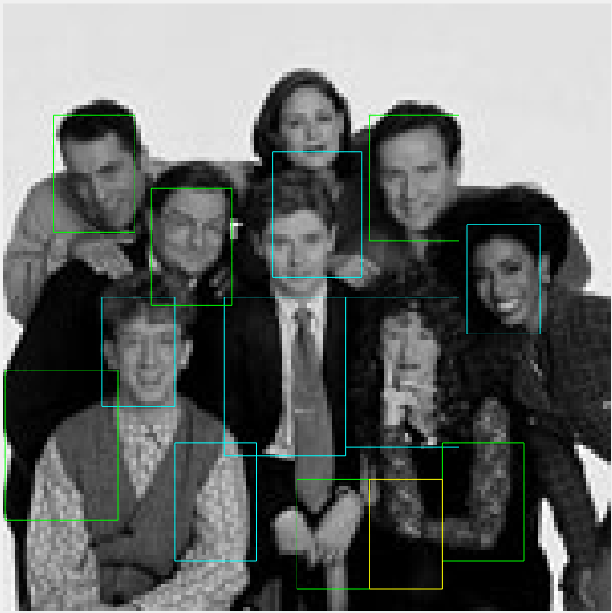
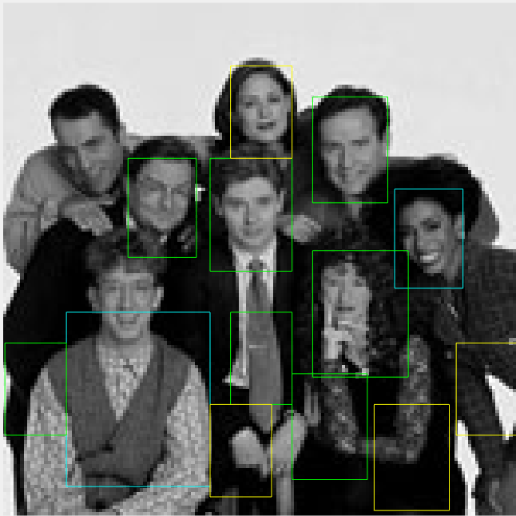
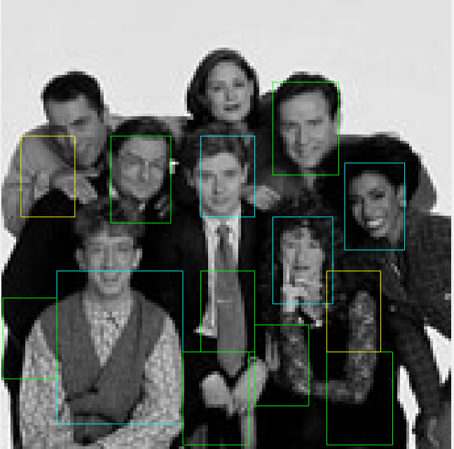
Full Image → Random Forest
10 Trees
100 Trees
200 Trees

Slide 18
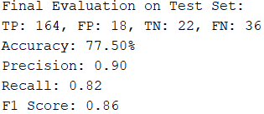
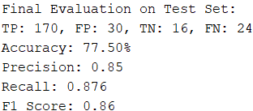
Full Image → Random Forest, Metrics evaluation
Model 1
Model 2
Notice how accuracy is the same at 77.5%.
This made us realize that other metrics are also useful to be evaluated, for example, recall and precision.
In model 2, a higher recall at a cost of lower precision means that model 2 would’ve captured more TP even if it gave more FP.
Depending on the purpose, model 2 can be more desirable. For example, if an operator wants to catch a criminal, and they do not mind manually reviewing through more (FP) photos for a chance at capturing a person that would’ve otherwise been lost in model 1.

Slide 19
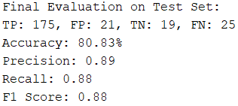
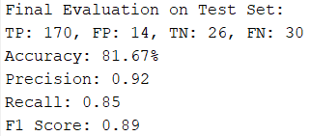
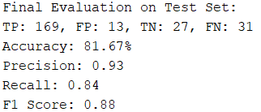
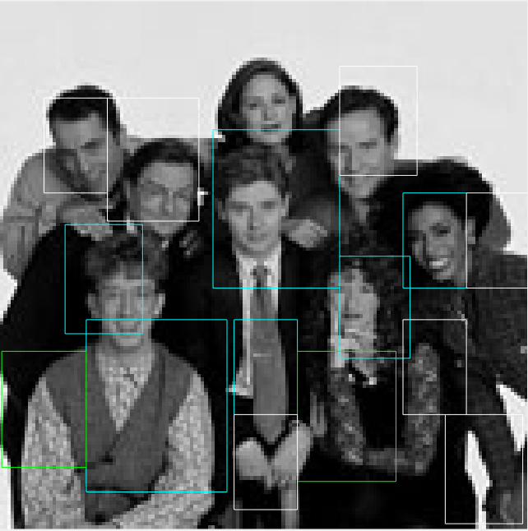
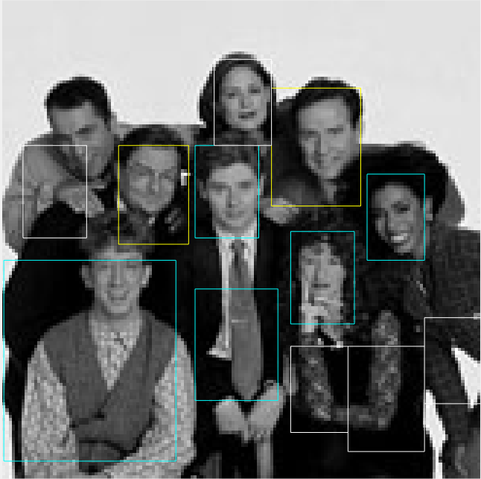
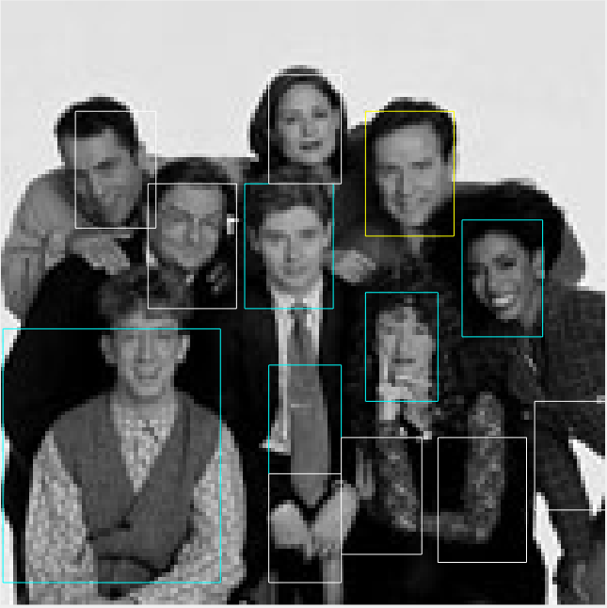
Full Image → AdaBoost
10 Weak learners
100 Weak learners
200 Weak learners

Slide 20
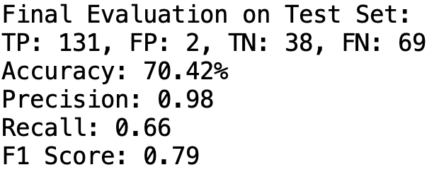
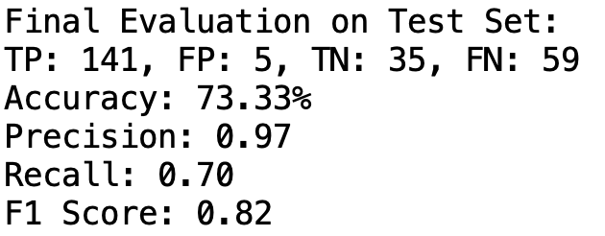
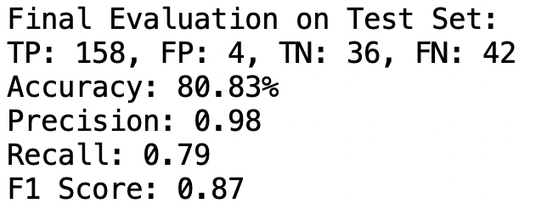







Full Image → MLP

Slide 21









Full Image → PCA → KNN
18x27 = 486 dimensions
3 dimensions
50 dimensions
100 dimensions
200 dimensions

Slide 22

Full Image → PCA → KNN → LOOCV
Accuracy changed from 92.5% to 96.26%, ceteris paribus.

Slide 23





HOG → KNN
Histogram equalization OFF
Histogram equalization ON
Detector looks better even though accuracy is lower

Slide 24


HOG → SVM

Slide 25


HOG → Standalone Decision Tree

Slide 26






HOG → Random Forest (10 & 50 & 100 Trees)
10 Trees
50 Trees
100 Trees

Slide 27






HOG → AdaBoost
10 Weak learners
100 Weak learners
200 Weak learners

Slide 28



Gabor → KNN

Slide 29



Gabor → SVM
Tried to play with hyperparameters of SVM (tried changing gaussian, changing ‘c’, changing lambda)
Tried to normalize data
Tried to remove low variance features
… but nothing worked still.

Slide 30


Gabor → Standalone Decision Tree

Slide 31





Gabor → Random Forest
10 Trees
50 Trees
100 Trees

Slide 32



Gabor → AdaBoost
10 Weak learners
100 Weak learners
200 Weak learners

Slide 33




Detector across im1-4.jpg, based purely on cross-validation accuracy metric
Full Image → KNN
Using full dataset: face_all.cdataset
Histogram eq = OFF
PCA = OFF
K = 2 (because accuracy was highest at 98.68% during LOOCV test)

Slide 34




Detector across im1-4.jpg, based on feeling
Full Image → MLP
Using full dataset: face_all.cdataset
Histogram eq = OFF
Architecture: Input → Hidden (10000 neurons) → ReLU → Hidden (5000 neurons) → ReLU
Epochs = 30
Iterations per epoch = 20

